Slide 1




Digital Portfolio
STUDENT NAME: Yuvaraj S
REGISTER NOAND NMlD:astvu30030024u18056
DEPARTMENT:Bsc.computer science COLLEGE: Thiruvalluvar University

Slide 2


PROJECT TITLE
Personal Digital Portfolio Website Using front end web develop
■

Slide 3

AGENDA
Problem Statement
Project Overview
End Users
"ools and Technologies
Portfolio design and Layout
eatures and Functionality
Results and Screenshots
Conclusion
Github Link

Slide 4

PROBLEM STATEMENT
In today’s digital era, students and professionals need an effective way to showcase their skills, projects, and achievements beyond traditional paper resumes. A static resume often fails to highlight interactive elements such as project demonstrations, contact forms, and responsive design for mobile users. Therefore, there is a need for a digital portfolio website that provides an engaging, accessible, and professional platform where a student can present their personal information, technical skills, academic background, and project work in an organized manner. This portfolio will serve as a personal brand identity and a medium to connect with recruiters, teachers, or collaborators.

Slide 5


PROJECT OVERVIEW
The Digital Portfolio Website is a personal web-based application developed using HTML,
CSS, and JavaScript. It is designed to provide an interactive platform for showcasing an individual’s academic details, technical skills, projects, and contact information in a professional manner.
The website consists of multiple sections such as About Me, Skills, Projects, and
Contact Form, making it easy for visitors to navigate and learn more about the student. The use of CSS ensures an attractive and responsive layout, while JavaScript adds interactivity, such as form validation and dynamic features like downloading a resume.

Slide 6
WHO ARE THE END USERS?
•
Students / The Portfolio
Owner
Recruiters / Employers
Teachers / Academic Mentors
General Visitors / Peers

Slide 7


TOOLS AND TECHNIQUES
HTML (HyperText Markup Language) - for creating the structure of the website (sections like About, Skills, Projects, Contact).
CSS (Cascading Style Sheets) - for styling, layout design, colors,
fonts,and making the site visually attractive and responsive.
JavaScript - for adding interactivity, such as form validation, Resume download button, and dynamic behavior.
Code Editor (VS Code / Sublime / Notepad++) - used to write and
manage the code files.
NOTE: hosting platform by the github pages

Slide 8

POTFOLIO DESIGN AND LAYOUT
Header Section
Contains the student’s name, a short tagline (e.g., “Web Development Learner”), and a Resume Downl Positioned at the top of the page with a highlighted background for visibility.
About Me Section
Provides a brief introduction about the student.
Includes details like academic background, interest in web development, and career goals.
Skills Section
Displays a list of technical skills (HTML, CSS, JavaScript, etc.). Presented in a bullet-point or grid layout for easy readability.
Projects Section
Highlights the student’s completed projects with titles and short descriptions. Each project is placed inside a card-style layout with proper spacing.
Contact Section
Contains a contact form (name, email, message fields) for visitors or recruiters to connect. Includes a “Send” button with JavaScript handling the form submission.
Footer Section
Displays copyright information.
Can include social media or GitHub/LinkedIn links.

Slide 9


FEATURES AND FUNCTIONALIT
Personal Branding - Displays student’s name, introduction, and career interests.
About Me Section - Provides details about education, passion for web development, and goals.
Skills Showcase - Lists technical skills (HTML, CSS, JavaScript, etc.) in an organized way.
Projects Section - Highlights completed projects with descriptions.
Contact Form - Allows visitors or recruiters to send messages directly.
Resume Download Option - Provides a button to download the student’s resume.
Responsive Design - Works seamlessly on desktops, tablets, and smartphones.
Clean UI/UX - Simple, user-friendly, and professional interface.

Slide 10

RESULTS AND SCREENSHOTS
Header (Top bar)
Left side: A square avatar box with initials “YN” inside a gradient background.
Next to it: Your name “Your Name” in bold, and below it a tagline like “Frontend Developer • Problem- solver • Lifelong learner”.
Right side: Navigation links → About | Projects | Contact | Toggle theme button.
  Hero Section (Main Intro Card)
A welcome message: “Hi — I’m yuvaraj.”
A short bio sentence.
Two buttons:
See my work (scrolls to Projects)
Download Resume (currently placeholder).
A skills tag list: HTML, CSS, JavaScript, React, Node.
On the right: A profile photo placeholder (square image with “Photo” text).
  Projects Section
Title: “Selected projects”.

Slide 11
Four clickable project cards:
Landing UI (HTML, CSS, JS)
Mini E-Shop (JavaScript, LocalStorage)
Data Viz Demo (D3, SVG)
Todo PWA (PWA, Service Worker)
Clicking on any project opens a modal popup showing its title and description, with a “View live” button.
  About Section
A short “About me” paragraph.
Another skills list: ES6+, Responsive CSS, Accessibility, Testing, Git.
  Sidebar (Right side on large screens, below on mobile)
Contact Card with a simple form (Name, Email, Message, Send button, Copy email button).
Contact details: email (syuavaraj008@gmail.com), location (Chennai, India), LinkedIn link.
Quick Info Card: “Available for hire • Open to freelance and remote roles. Experience: 2+ years.”
  Footer
“© 2025 yuvaraj— Built with ”
  Modal Popup (Hidden until project is clicked)
Shows project title, description, and a “View live” button.

Slide 12
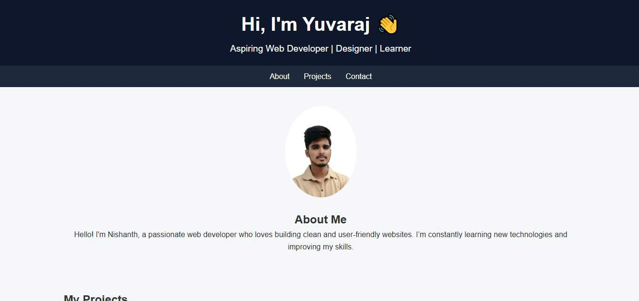
Screenshorts of the webpage

Slide 14

CONCLUSION
The Digital Portfolio Website successfully demonstrates the application of HTML, CSS, and JavaScript in building a responsive and interactive personal website.
It provides a structured platform for showcasing an individual’s academic background, skills, projects, and contact details in a professional and visually appealing manner.
Through this project, the student has gained practical knowledge of front-end web development, responsive design principles, and basic interactivity using JavaScript. The website not only acts as a modern replacement for a traditional resume but also enhances the student’s online presence, making it easier for recruiters, mentors, and peers to evaluate their skills and connect with them.

Slide 15
Github link:
appas-123/TNSDC-FWD-DigitalPortfolio

